Slide 1
Active Navigation Administrator Starter
Indexing for Content Discovery and Analysis

Slide 2
Process and Role Overview
Active Navigation Administrator undertakes and manages:
  Rules for metadata extraction and storage
  Index configuration and index definition
  Task queuing and progress monitoring for indexing and actions
Calculated fields and extraction rules are defined to capture metadata
Index configurations determine which indexes capture what metadata
The AN Administrator defines and manages indexes to collect metadata required for reporting
The activity queue is used to prioritize manage task progress
Manually updated metadata values are imported when required
System Configuration
Indexing: Skim
Report Review and Action
Roles
System Admin
Indexing: Duplication
Report Review and Action
Active Navigation Admin
Indexing: Analysis
Report Review and Action
Information Manager
File Metadata Import
File Metadata Review and Update
Reviewer

Slide 3
Discovering Files (Skim)
The index skim process discovers files and containers/folders
Skim processes files rapidly and so is effective for large volumes of content
Skim builds a comprehensive inventory and can be effective for
  Content clean up
  Storage optimization and re-structuring
  Capture of metadata stored in file and folder names

Slide 4
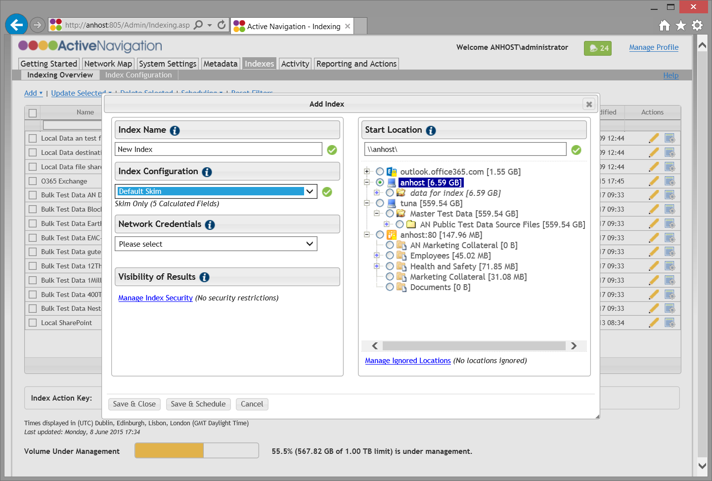
IN1 Index (Skim) Content
Go to Indexes > Indexing Overview
Click Add > Add Index
Configure the index
  Enter a descriptive name
  Select Default Skim configuration
  Choose a Start Location from the Network Map
No need to change Network Credentials
  These will have been pre-configured by your system administrator
Click Save & Schedule
  The scheduling dialog box will appear
Click Save

Slide 5
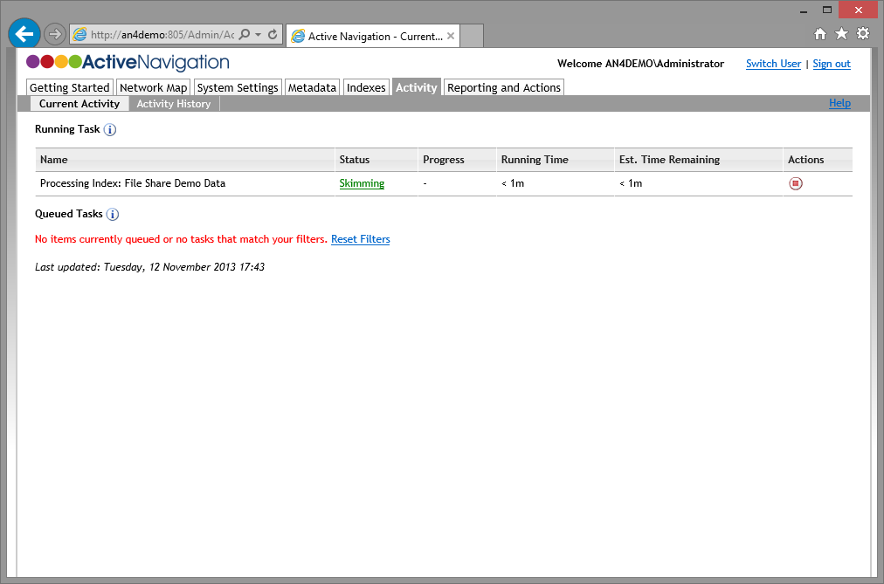
IN1 Monitor Progress
Go to Activity > Current Activity
Running Task will show the index being processed in stages
  Skimming
  Classifying
On completion a Process Reporting Database task will be run
Once all tasks are complete, reports will be available to view

Slide 6
Analyzing Duplicate Files
Indexes analyze the contents of files to determine the presence of duplicate files
Duplicate analysis takes significantly longer than the equivalent skim process for the same volume of content

Slide 7
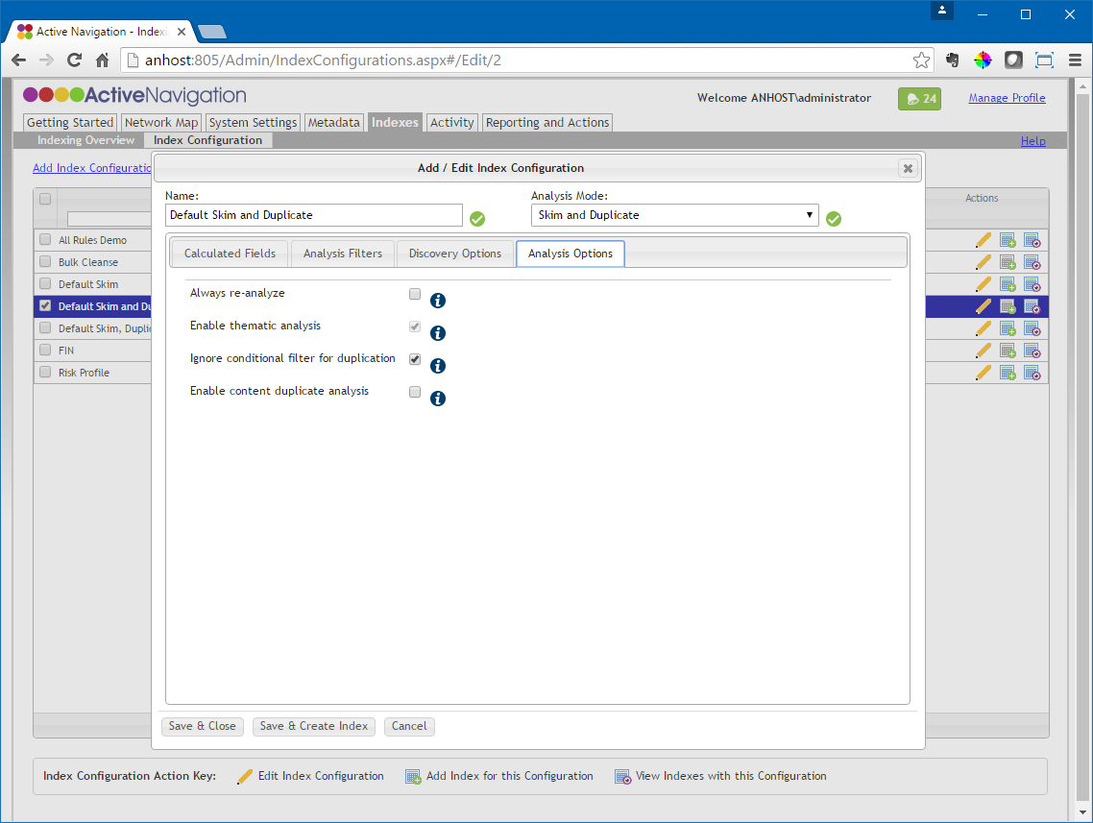
IN2 Confirm/Set Duplicate Analysis Filters
Go to Indexes > Index Configuration
Locate and edit the Default Skim and Duplicate configuration
  In the Add/Edit Index Configuration dialog click Analysis Options
  Ensure Ignore conditional filter for duplication is checked
Click Save & Close

Slide 8
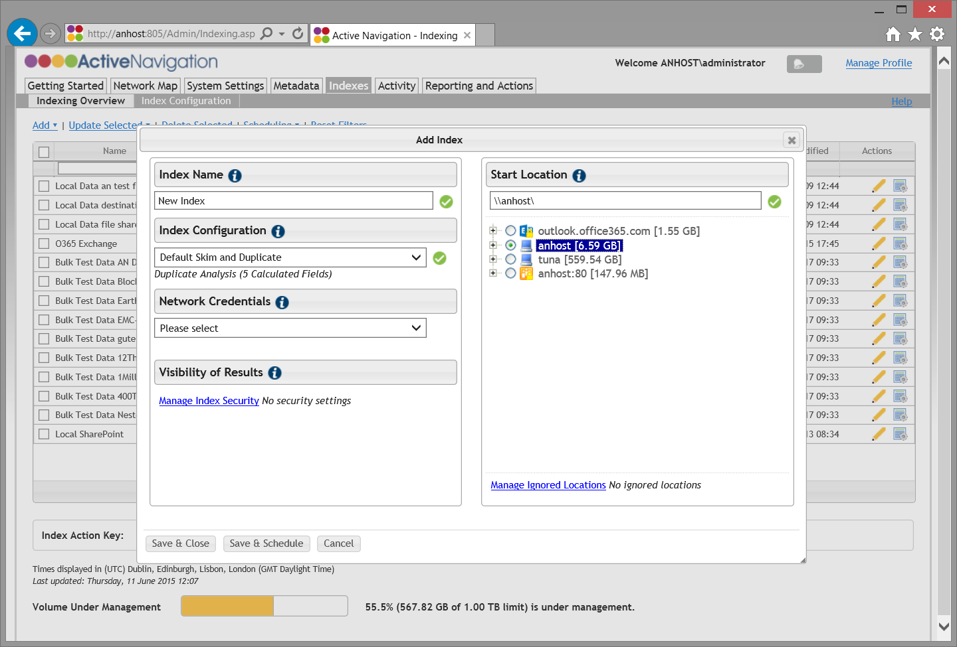
IN2 Index Duplicate Analysis
Go to Indexes > Indexing Overview
Click Add > Add Index
Configure the index
  Enter a descriptive name
  Select Default Skim & Duplicates configuration
  Choose a Start Location from the Network Map
No need to change Network Credentials
  These will have been pre-configured by your system administrator
Click Save & Schedule
  The scheduling dialog box will appear
Click Save

Slide 9
Analyzing Text Contents of Files
Index analysis extracts the text contents of files that have been previously discovered
Calculated fields are assigned to index configurations to define what metadata is captured during analysis
Textual analysis takes significantly longer than the equivalent skim process for the same volume of content

Slide 10
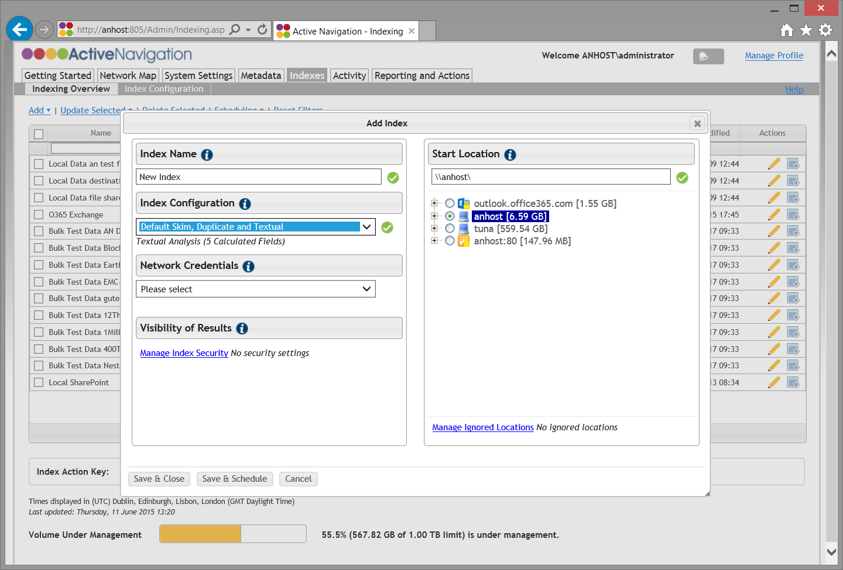
IN3 Index Analysis
Go to Indexes > Indexing Overview
Click Add > Add Index
Configure the index
  Enter a descriptive name
  Select Default Skim, Duplicates and Textual configuration
  Choose a Start Location from the Network Map
No need to change Network Credentials
  These will have been pre-configured by your system administrator
Click Save & Schedule
  The scheduling dialog box will appear
Click Save

Slide 11
IN3 Monitor Progress
Go to Activity > Current Activity
Running Task will show the index being processed in stages
  Skimming
  Analyzing
  Classifying
On completion a Process Reporting Database task will be run

Slide 12
Managing Indexes
It is common in a working project to define many indexes
Discovery Center provides a range of facilities to help the Active Navigation Administrator effectively manage and work with indexes in bulk

Slide 13
IN4 Terminology
Index configuration
  A re-usable set of options which, when applied to an index determine how that index will behave
Index credentials
  The account used to provide the privileges necessary for an index to discover content
  Credentials are managed centrally by the System Administrator
Index security
  The settings that determine who can see the file-level results of the index process

Slide 14
IN4 Key Concepts
Index configurations control the way indexes process content
  Changing a configuration changes the way all related indexes behave
  Using configurations ensures indexes run consistently
  Configurations support easy bulk index management
The System Administrator controls how new locations and repositories are made available for indexing
  Add new locations to the Network Map
  Add credentials to the Network Map for indexing and actions
  The Index Multi-Add feature will only be available to users with System Administrator privileges

Slide 15
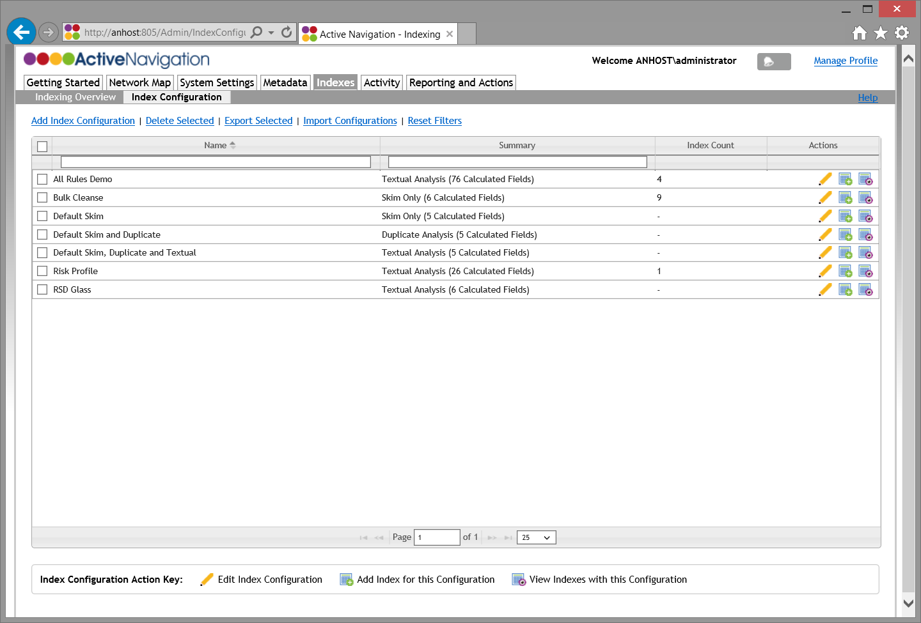
IN4 Index Configurations
Go to Indexes > Index Configuration
Click Add Index Configuration to create a new unique configuration
Edit a configuration to change how dependent indexes process files
Create a new index using an existing configuration
Show an overview of indexes with that configuration
Create new index
Edit index configuration
Show related indexes

Slide 16
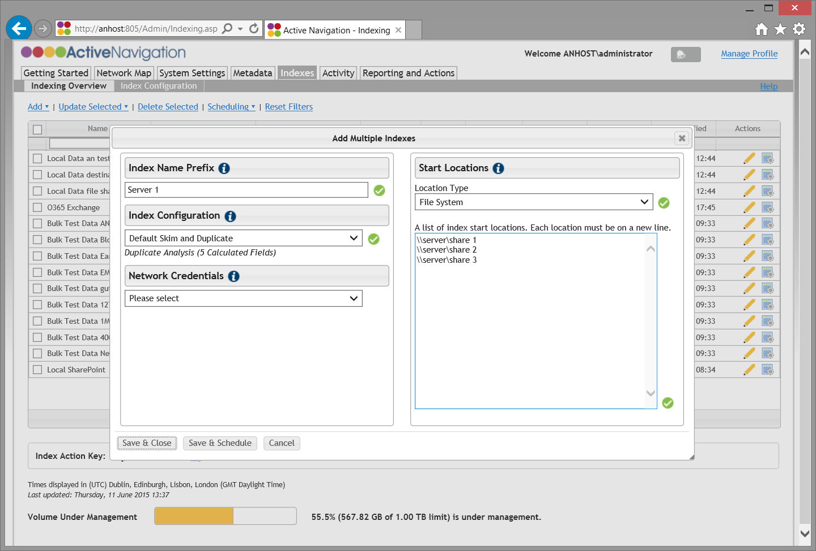
IN4 Create Multiple Indexes
Go to Indexes > Indexing Overview
Click Add > Add Multiple
  Enter a meaningful Name Prefix to be used for all indexes
  Select an Index Configuration
  Choose a Location Type
  Paste or type a list of UNC/URL paths for the start locations to be used
  Choose credentials to apply for pasted locations
  Click Save & Close
To add multiple indexes you must be in both the Active Navigation Administrator and System Administrator roles

Slide 17
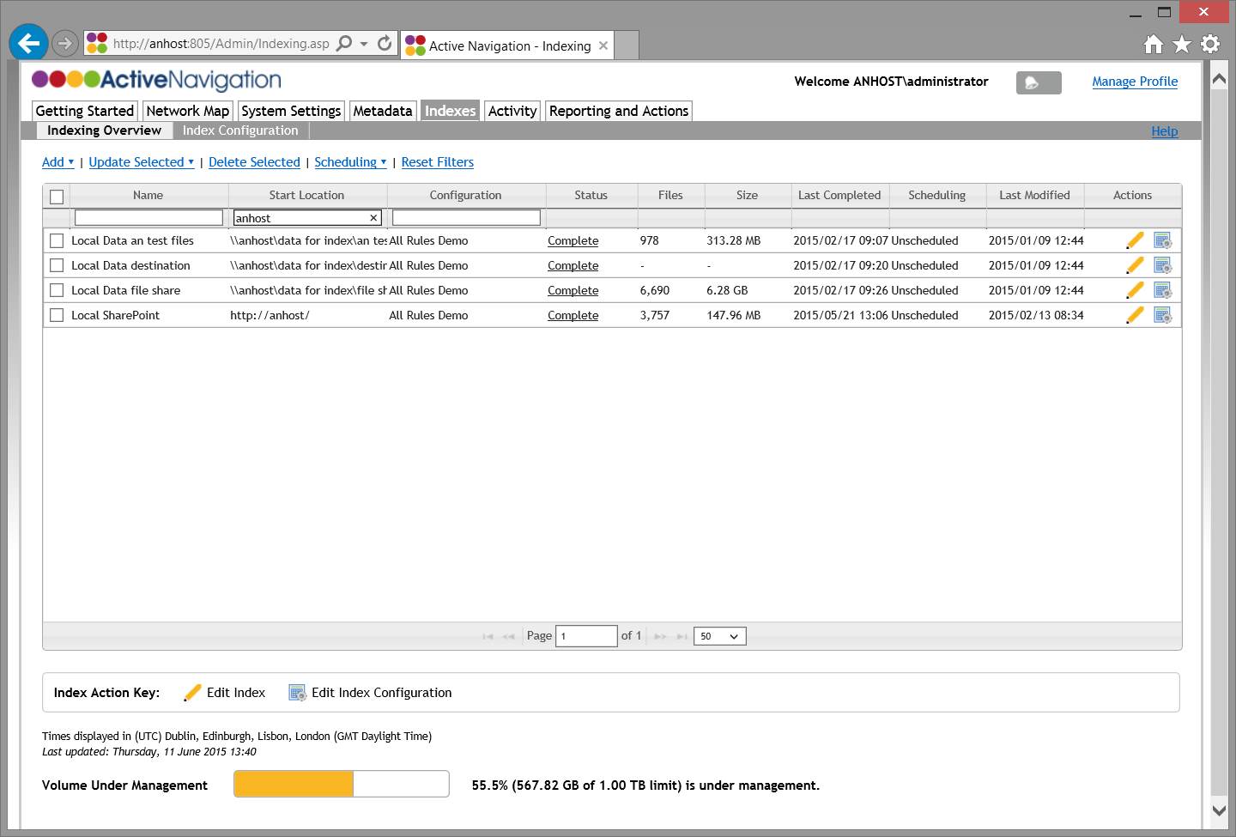
IN4 Filter Index Overview
Filter a long list of indexes to find the ones you need
Go to Indexes > Indexing Overview
Type text into a filter box at the top of the index list, and press Enter
  Use parts of index names
  Pick out specific index configurations
  Select start locations with common terms
To clear a filter, click on the filter box, clear the term and then press Enter

Slide 18
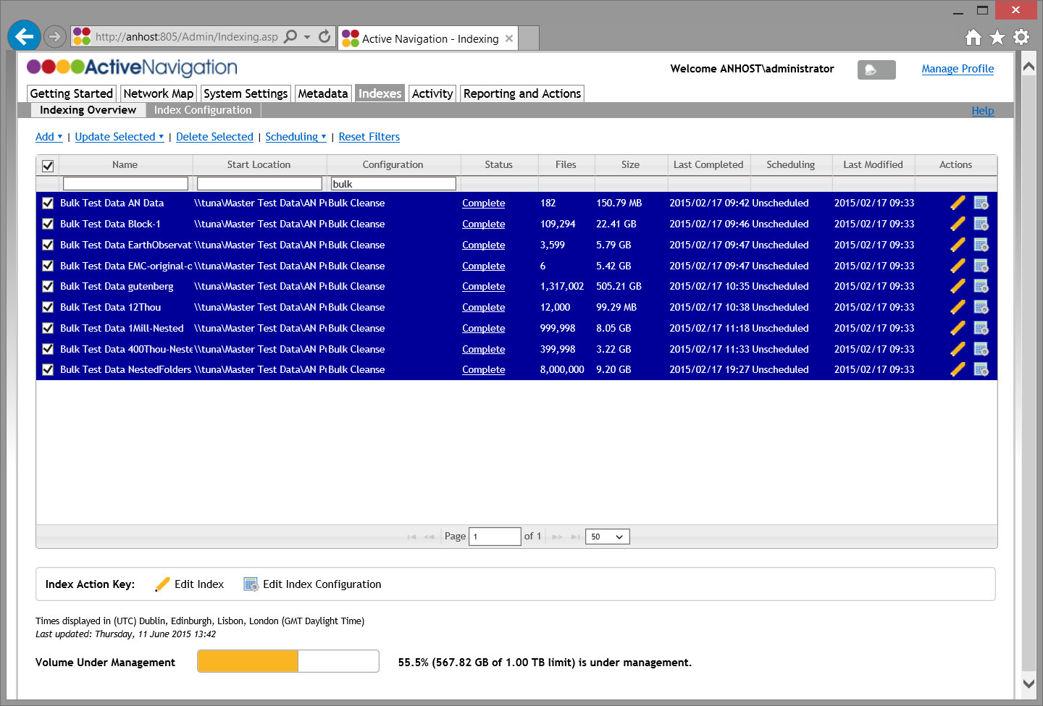
IN4 Edit Multiple Indexes
Type in the filter boxes to focus on specific types of indexes
Use the checkboxes to select one or more indexes
Click Update Selected menu to access options to change all selected indexes
Click Edit Configuration icon to change the related Index Configuration
Edit index configuration

Slide 19
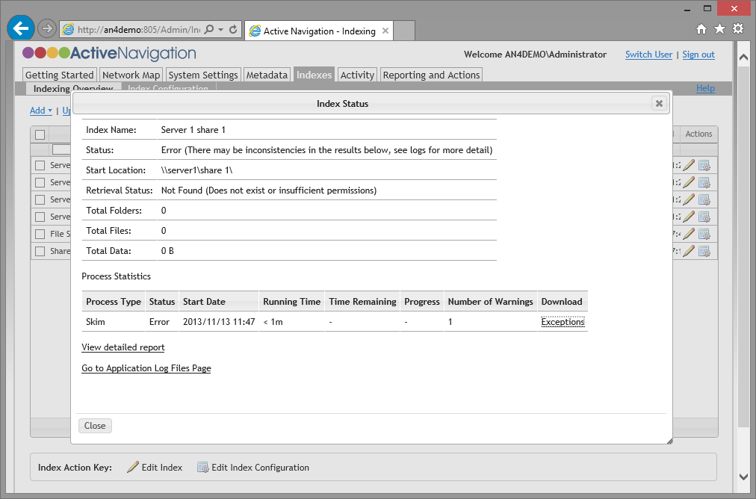
IN4 Simple Index Troubleshooting
Indexes will fail if
  The target repository is not available
  An incorrect UNC/URL path is provided
  The index or scheduler does not have permissions to read all of the content
Index Status and Retrieval Status will report an indexing error
Click on the Exceptions link to view a list of failures
Full log files are available to Active Navigation Administrator and System Administrator roles

